Slide 1

TASK ON
Code Refactoring and Bug Fixing

Slide 2
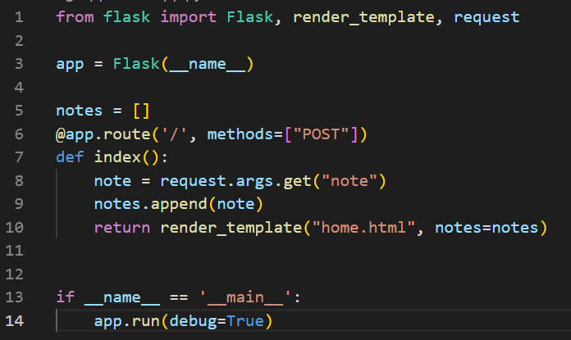
Bug Finding in Application Server
Method is set to be “POST” only. “POST” method used to write data using request. But we also require to Read data from server using request.
Here Data is not transfer using URL. Data is Transfer using HTML Form element.
1
2

Slide 3
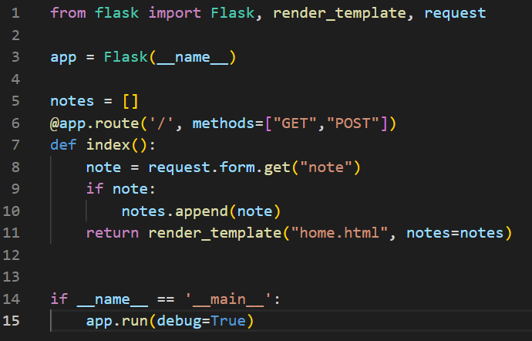
Bug Fixing in Application Server
To add “GET” also in method parameter of route in Python Flask Application Server.
To read data from HTML Form element. Get note using request.form.get(“note”).
If we receive any empty data means it also add with existing Notes. In order to avoid empty data we have to check for notes if it is not empty then add to our database.

Slide 4
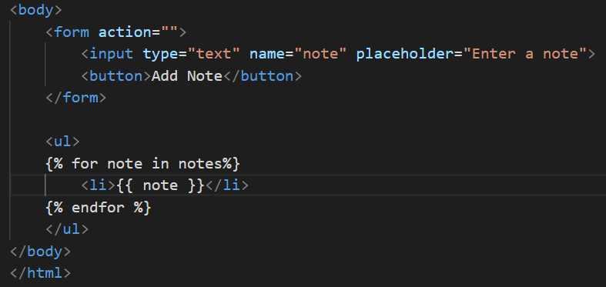

Bug Finding in HTML
2
In Form Element Method is missing.
In Button tag type parameter is missing

Slide 5
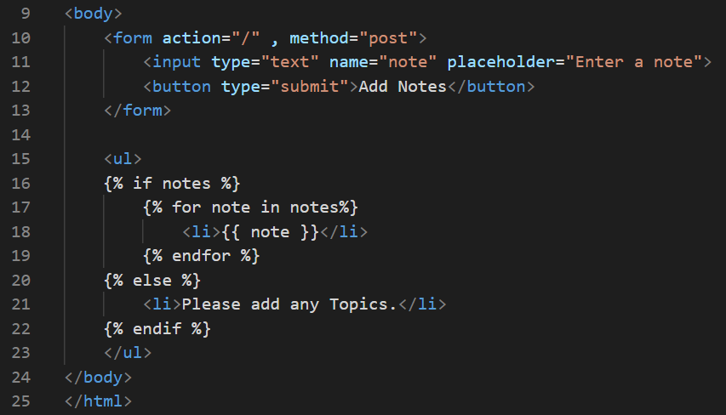
Bug Fixing in HTML
Fill method=“post” in the form element.
Fill type=“submit” in button tag.
If our notes database is empty then its show Please add any Topics if any notes present in database it start showing notes.

Slide 6
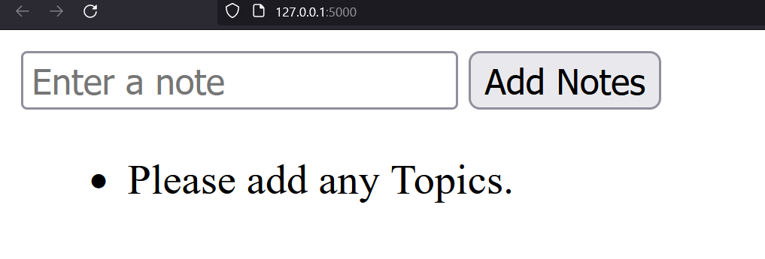
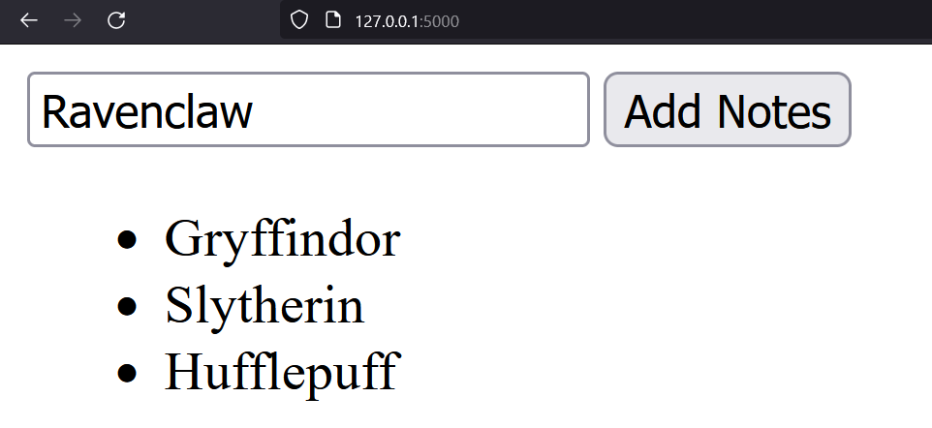
Final Output after Fixing

Slide 7

THANK YOU

